Slide 1
GLOBAL INSTITUTE OF TECHNOLGY JAIPUR
Technical Communication
Computer Science
Unit 1: Importance, Objectives & Characteristics of Technical Communication
Punit Shukla

Slide 2

Mr.Punit Shukla
GLOBAL INSTITUTE OF TECHNOLGY JAIPUR
Technical Communication
Computer Science
To understand that technical communication is written for and about business and industry and focuses on products and services.
To apply/experiment various oral and written channels of communication, dependent upon the audience, purpose, and situation.
To recognize that technical communication costs a company both time and money, so employees must strive to write effectively.
To recognize the importance of teamwork in technical communication
To understand that Human Performance Improvement (HPI) solves problems—“gaps”—inherent in teamwork.
Punit Shukla

Slide 3

GLOBAL INSTITUTE OF TECHNOLGY JAIPUR
Technical Communication
Computer Science
To face problems incorporating varied knowledge levels, differing motives, and insufficient resources.
To use group-ware for collaborative projects.
To recognize that conflict resolution strategies are essential to a team’s success.
To resolve conflicts in a team by setting guidelines, encourage all participants and avoid partiality or nepotism.
Punit Shukla

Slide 4

Technical Communication: Scope
GLOBAL INSTITUTE OF TECHNOLGY JAIPUR
Mr.Punit Shukla
Technical Communication
Computer Science
Technical Communication: Oral and written communication for and about business and industry. Focused writing conveys how products and services are:
  Manufactured
  Marketed
  Managed
  Delivered
  Used
Punit Shukla

Slide 5
GLOBAL INSTITUTE OF TECHNOLGY JAIPUR
Technical Communication
Computer Science
Speaking to Customers
Writing correspondence
Preparing Power-Point Presentations
Writing Reports (Project & Technical)
Marketing
Blogging
Punit Shukla

Slide 6
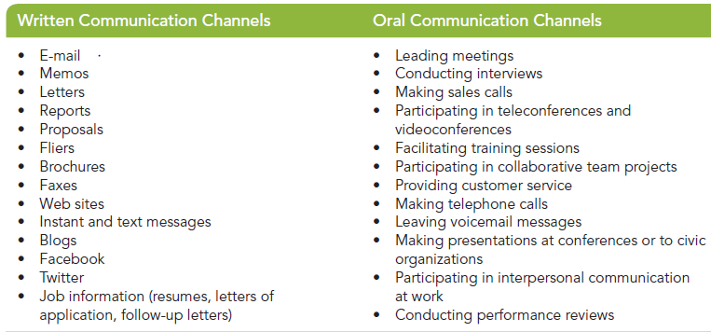
GLOBAL INSTITUTE OF TECHNOLGY JAIPUR
Technical Communication
Computer Science
Punit Shukla

Slide 7
GLOBAL INSTITUTE OF TECHNOLGY JAIPUR
Technical Communication
Computer Science
Smart-phones are impacting the size, speed, mobility, and tone to Technical Correspondence.
Values include:
- portability and mobility
- multitasking
- immediate feedback
- use of various apps
Punit Shukla

Slide 8
GLOBAL INSTITUTE OF TECHNOLGY JAIPUR
Technical Communication
Computer Science
Mr.Punit Shukla
On job, an individual requires to write and speak effectively.
Technical communication is a major component of operating a business. It……
  serves valuable purposes on the job
  helps you find a job
  meet the needs of customers
In addition, being an effective communicator; ensures productivity and saves running cost.
Punit Shukla

Slide 9
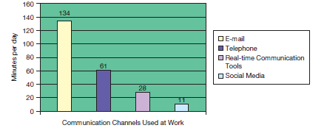
GLOBAL INSTITUTE OF TECHNOLGY JAIPUR
Technical Communication
Computer Science
Punit Shukla

Slide 10

GLOBAL INSTITUTE OF TECHNOLGY JAIPUR
Technical Communication
Computer Science
Silo building is when employees isolate themselves, focus too narrowly, and fail to collaborate.
Silos stifle cross-pollination of ideas and disallow open lines of communication.
Teamwork prevents silo building and enhances productivity in variety of ways.
Punit Shukla

Slide 11

Mr.Punit Shukla
GLOBAL INSTITUTE OF TECHNOLGY JAIPUR
Technical Communication
Computer Science
Teamwork benefits both diverse teams (people of different areas of expertise, ages, genders, cultures, and races) and dispersed teams (people working in different locations and time zones) and achieves the following:
- Promotes diversity of opinion
- Provides checks and balances
- Creates broad-based understanding
- Empowers individuals
- Encourages common goals
Punit Shukla

Slide 12

GLOBAL INSTITUTE OF TECHNOLGY JAIPUR
Mr.Punit Shukla
Technical Communication
Computer Science
Groupware includes the following tools:
Electronic conferencing tools (webinars, listservs, message and discussion boards, videoconferences, teleconferences)
Electronic management tools (digital dashboards, project management software, electronic calendaring)
Electronic communication tools (Instant messages, e-mail, blogs, intranets and extranets, wikis)
Social media (Facebook, YouTube, Twitter, etc.)
Punit Shukla

Slide 13
GLOBAL INSTITUTE OF TECHNOLGY JAIPUR
Technical Communication
Computer Science
Some tools are more synchronous and interactive than others; choose what works best
A wiki is a Web site that allows users to add, remove, or edit documents. Benefits include:
  Involvement of all team members
  Less need for face-to-face communication
  Avoidance of excessive and lengthy e-mails
  Team organization and privacy
Punit Shukla

Slide 14

GLOBAL INSTITUTE OF TECHNOLGY JAIPUR
Technical Communication
Computer Science
Google Docs and Google Sites are online tools that allow document sharing, collaborating on group projects, and publishing to the Internet.
Benefits of Google Sites include:
- Easily to create Web-Pages
- Collecting all of your information in one place
- Controlling who can view and edit
Punit Shukla

Slide 15
GLOBAL INSTITUTE OF TECHNOLGY JAIPUR
Technical Communication
Computer Science
Benefits of Google Docs include:
- Uploading and saving files
- Editing and viewing a document
- Showing changes in real time
- Viewing a document’s revision history
- Returning to earlier versions
- Adding new team members or deleting writers
- Choosing who can access your site
Punit Shukla

Slide 16

GLOBAL INSTITUTE OF TECHNOLGY JAIPUR
Technical Communication
Computer Science
Teamwork can involve a host of challenges
Human Performance Improvement (HPI) solves problems inherent in teamwork by focusing on common areas:
Knowledge Resources Processes Information Support | Wellness Acknowledgement Trust Leadership Efficient communication
Punit Shukla

Slide 17

GLOBAL INSTITUTE OF TECHNOLGY JAIPUR
Technical Communication
Computer Science
Once problems are identified, techniques to solve them include:
- Improved compensation packages
- Employee recognition programs
- Revised performance appraisals
- Improved employee training
- Mentoring or coaching
- Safety implementations
- Strategic planning changes
Punit Shukla

Slide 18
GLOBAL INSTITUTE OF TECHNOLGY JAIPUR
Technical Communication
Computer Science
To avoid or resolve conflicts in collaborative groups, consider these techniques:
  1) Choose a Team-Leader
  2) Set Guidelines
  3) Ensure compatible hardware and software availability with all.
  4) Encourage equal discussion and involvement
  5) Discourage taking sides
Punit Shukla

Slide 19
GLOBAL INSTITUTE OF TECHNOLGY JAIPUR
Technical Communication
Computer Science
  6) Seek consensus
  7) Table topics when necessary
  8) Create subcommittees
  9) Find the good in the bad
  10) Deal with individuals individually
Punit Shukla

Slide 20
GLOBAL INSTITUTE OF TECHNOLGY JAIPUR
Technical Communication
Computer Science
1. Technical communication is written for and about business and industry and focuses on products and services.
2. You will use various channels of communication, dependent upon the audience, purpose, and situation.
3. Technical communication costs a company both time and money, so employees must strive to write effectively.
Punit Shukla

Slide 21
GLOBAL INSTITUTE OF TECHNOLGY JAIPUR
Technical Communication
Computer Science
4.The top five skills employers want include communication skills, honesty, teamwork, a strong work ethic, and analytical skills.
5. Avoid “silo building,” isolating yourself on the job.
6. Working in teams allows you to see issues from several points of view.
7. Human Performance Improvement (HPI) solves problems—“gaps”—inherent in teamwork.
Punit Shukla

Slide 22
GLOBAL INSTITUTE OF TECHNOLGY JAIPUR
Technical Communication
Computer Science
8. Teams face problems including varied knowledge levels, differing motives, and insufficient resources.
9. Conflict resolution strategies are essential to a team’s success.
10. To resolve conflicts in a team, you should set guidelines, encourage all to participate, and avoid taking sides.
Punit Shukla

Slide 23

Mr.Punit Shukla

